Slide 1
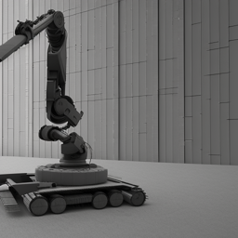

Prototyping Project
ROS Visualization and Detection of Virtual Rebars using
Radar Scanner
Qirjako Panoti Matr.No 429826
Omar Aldohami Matr.No 429852
Mohamad Albaaj Matr.No 429905

Slide 2
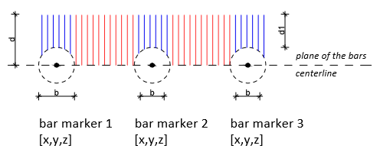
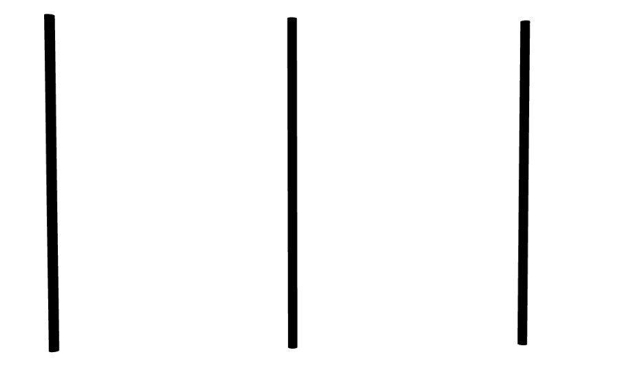
Mathematical Model
1) Given points X1 and X2 on line L with directional vector d=(𝑥2−𝑥1)⃑𝑖+(𝑦2−𝑦1)⃑𝑗+(𝑧2−𝑧1)⃑𝑘
x2
L
x1
x1
d
x2

Slide 3
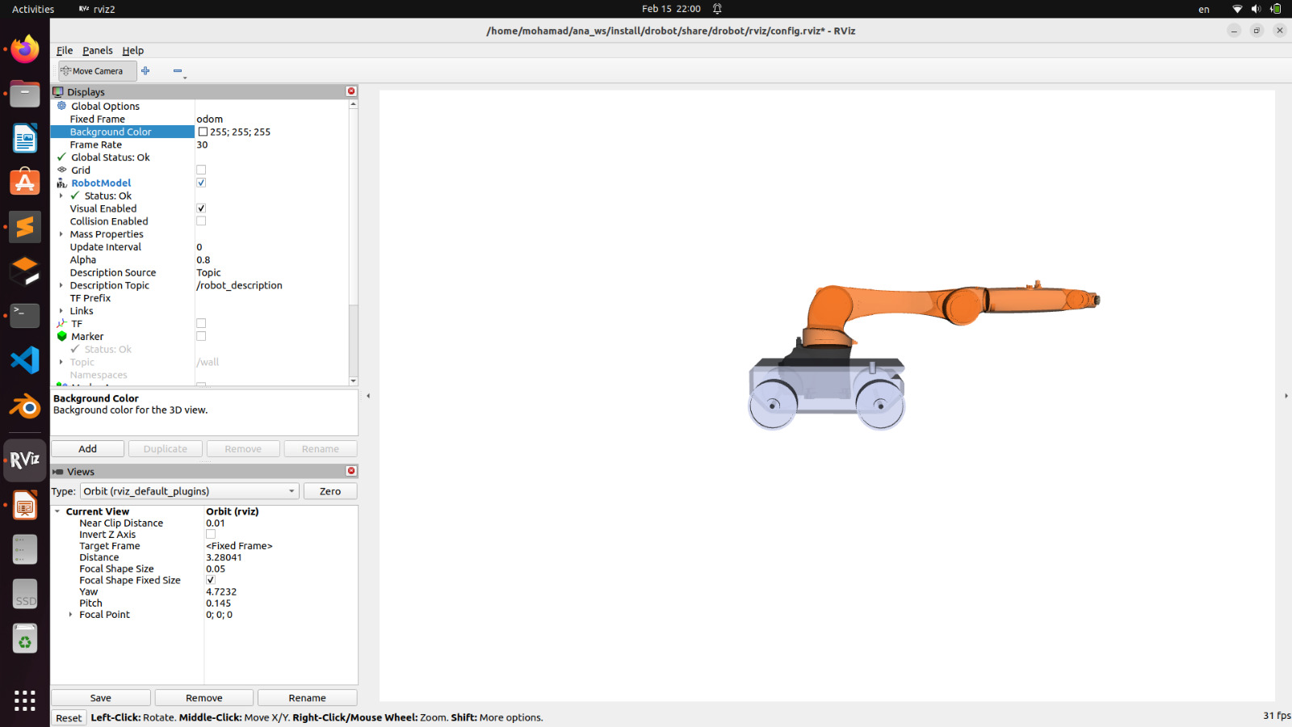
Mathematical Model
2) Given a point X0 in space,
x2
L
x1
x0
x0
xi

Slide 4
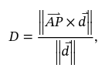
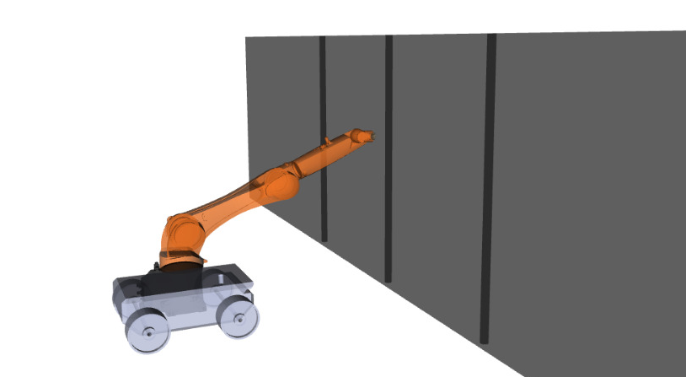
Mathematical Model
Find the shortest distance D from the point X0 to line L
x2
L
x1
where A = X1
And P = X0
D
x0

Slide 5
Distance_Calculator.py
line_points = [[3.6, 0.0, 0.5], [3.6, 1.0, 0.5], [3.6, -1, 0.5]]
line_directions = [[0.000001, 0.000001, 1], [0.000001, 0.000001, 1], [0.000001, 0.000001, 1]]
transform = self.tf_buffer.lookup_transform("odom","head", rclpy.time.Time())
x = transform.transform.translation.x
y = transform.transform.translation.y
z = transform.transform.translation.z
for i in range(3):
line_point = line_points[i]
line_direction = line_directions[i]
distance = sqrt(sum([(point[i] - line_point[i])**2 for i in range(3)]) - (sum([(point[i] - line_point[i]) * line_direction[i] for i in range(3)])**2 / sum([i**2 for i in line_direction])))

Slide 6
Distance_Calculator.py
Boundary zone
if distance < 0.2:
self.rebar_detections.append([t, x, y, z, distance])
print("Time: {}, Translation: x = {}, y = {}, z = {}, Distance to line = {}".format(t, x, y, z, distance))
print("Rebar is detected")

Slide 7
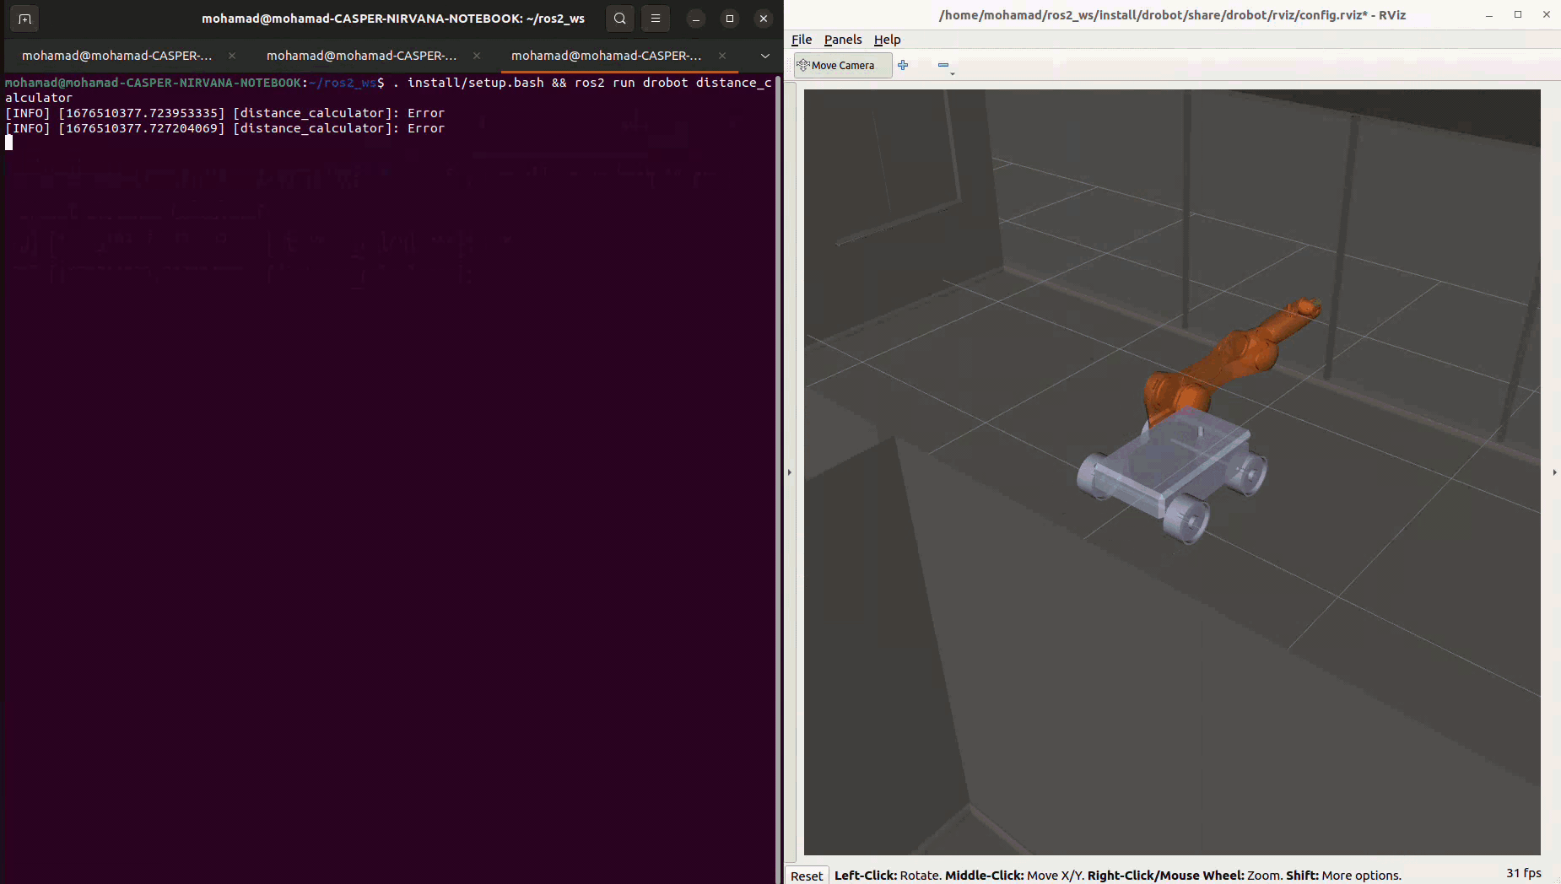
Rebar Detection

Slide 8
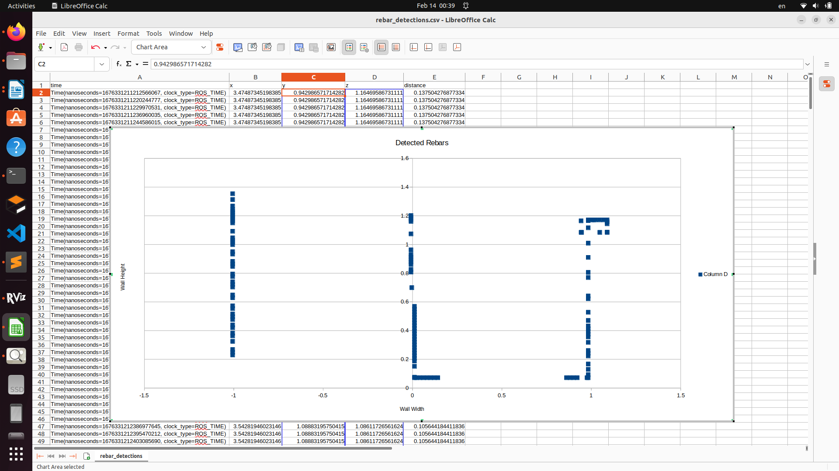
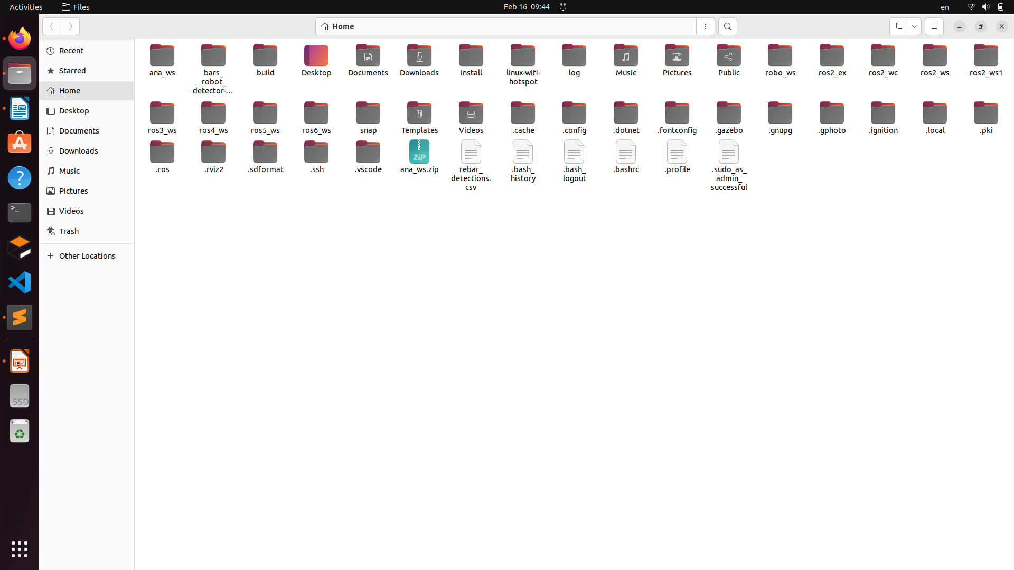
Rebar Detection
Export to CSV

